Slide 1


Introduction to
Robotic Process Automation
Online Exam Registration Reminder Bot
220701516
Balamurugan M
Mrs. J. Jinu Sophia
Assistant Professor (SG)
Department of Computer Science and Engineering

Slide 2
Abstract
The Online Exam Registration Reminder Bot is an automation solution developed to streamline the process of notifying users about approaching exam registration deadlines. This bot reads exam schedules and deadlines from an Excel file, calculates the remaining days until each deadline, and sends personalized email reminders to students whose deadlines are within three days. By leveraging activities such as data extraction, conditional checks, and email automation, the bot ensures timely communication and reduces the risk of missed registrations. The project incorporates error handling, logging, and data updates, providing a robust and efficient workflow. Additionally, secure methods like credential storage and dynamic scheduling ensure data privacy and seamless daily execution. This bot is particularly useful for educational institutions and organizations, offering a scalable, reliable, and user-friendly way to manage registration notifications and enhance productivity.

Slide 3
Need for the Proposed System
The increasing reliance on online examination systems has amplified the challenges of managing timely registrations effectively. Many candidates often miss important deadlines due to lack of awareness or forgetfulness, leading to missed opportunities and increased administrative burdens for educational institutions.
The Online Exam Registration Reminder Bot addresses these challenges by providing an automated, efficient, and reliable system for notifying candidates about upcoming registration deadlines. This reduces dependency on manual reminders, minimizes errors, and enhances user experience. Key drivers for the system's necessity include:
1. Eliminating Human Errors: Manual communication can lead to oversight, inaccuracies, and missed notifications. Automation ensures consistency and reliability.
2. Improved Time Management: Candidates are prompted well in advance to complete registrations, reducing last-minute rushes.
3. Administrative Efficiency: Educational institutions can save significant time and effort by automating routine tasks such as sending reminders.
4. Accessibility: The system ensures that candidates across different demographics receive timely notifications through email, bridging gaps in communication.
5. Scalability: As the number of candidates grows, manual tracking becomes unfeasible, making automation indispensable.

Slide 4
Advantages of the Proposed System
Advantages of the Proposed System (Top 5):
1. Automation of Reminders:
Eliminates the need for manual tracking and communication, ensuring timely notifications for all candidates.
2. Error Reduction:
Minimizes human errors in scheduling and reminder dispatch, leading to improved reliability.
3. Time Efficiency:
Speeds up the process of sending reminders, allowing administrators to focus on other critical tasks.
4. Cost Effectiveness:
Reduces the operational costs associated with manual tracking and communication methods.
5. Enhanced User Experience:
Provides candidates with timely and personalized reminders, improving their overall satisfaction with the service.

Slide 5
Literature Survey
Paper 1: Automated Online Exam Proctoring
Source: IEEE Xplore
Link: https://ieeexplore.ieee.org/document/7828141
Advantages:
- Reduces manual intervention in proctoring
- Enhances security and compliance in exam settings
Disadvantages:
- Implementation cost is high
- May raise privacy concerns among users
Paper 2: Automated Online Exam Proctoring System Using Computer Vision and Hybrid ML Classifier
Source: IEEE Xplore
Link: https://ieeexplore.ieee.org/document/9929456
Advantages:
- Highly accurate anomaly detection
- Can be integrated into existing online exam systems
Disadvantages:
- Heavy reliance on high-performance hardware
- Potential challenges with model bias and false positives

Slide 6
Main Objective
The primary objective of this project is to develop a bot that automates the process of sending reminders about exam registration deadlines. The bot ensures timely notifications, reduces dependency on manual follow-ups, and minimizes the risk of missed deadlines. Additionally, it aims to integrate seamlessly with existing exam management systems, offering a user-friendly and efficient approach to communication. By automating this process, educational institutions can focus on other critical tasks, while students receive consistent and accurate updates.

Slide 7
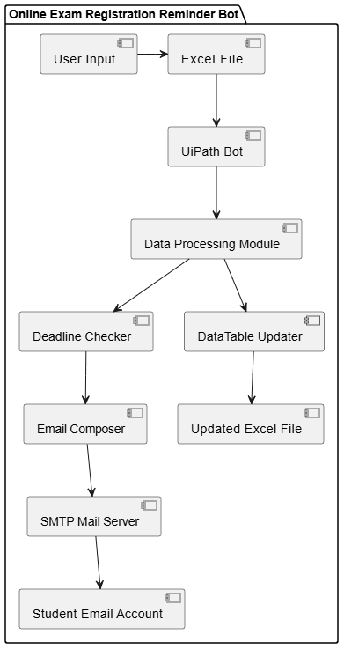
Architecture

Slide 8
System Requirements
Hardware
1. Processor: Intel Core i3 or equivalent (minimum); Intel Core i5 or higher (recommended)
2. RAM: 4 GB
3. Storage: At least 20 GB of free space.
Software
  - Operating System: Windows 11
  - UiPath Studio: For designing and deploying the automation workflows.
  - Microsoft Excel: For managing input and output data.
  - UiPath Orchestrator: For scheduling and monitoring workflows.

Slide 9
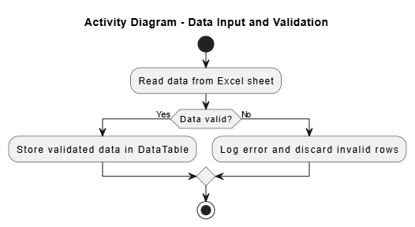
Functional Description
Module 1: Data Input and Validation
This module handles data ingestion from Excel sheets and validates entries to ensure no missing or incorrect information. It reads user information, including names, emails, and exam deadlines, and prepares the data for processing.

Slide 10
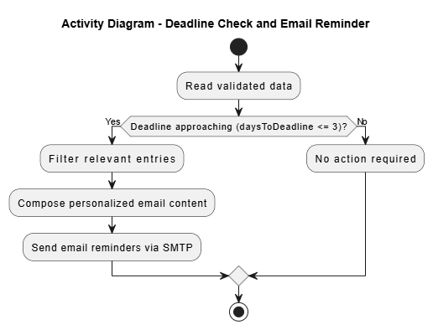
Functional Description
Module 2: Deadline Check and Email Reminder
This module compares current dates with exam registration deadlines. If deadlines are close, it composes and sends email reminders to the users whose deadlines are within the specified threshold.

Slide 11
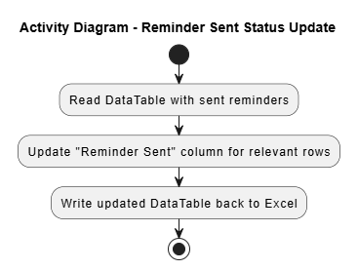
Functional Description
Module 3: Reminder Sent Status Update
This module updates the "Reminder Sent" column in the Excel sheet after reminders are sent.

Slide 12
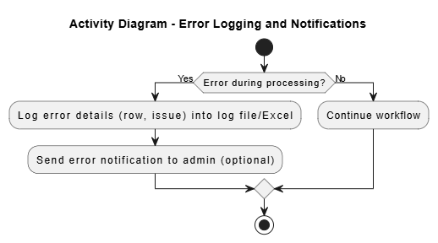
Functional Description
Module 4: Error Logging and Notifications
This module captures errors (e.g., email sending failures) and logs them in a dedicated Excel sheet or file.

Slide 13
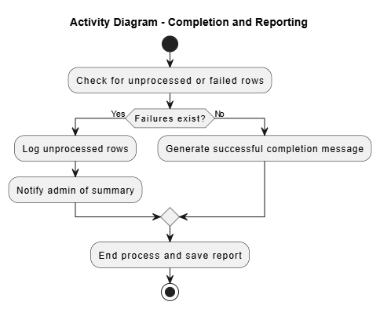
Functional Description
Module 5: Completion and Reporting
This module concludes the workflow and generates a summary report.

Slide 14
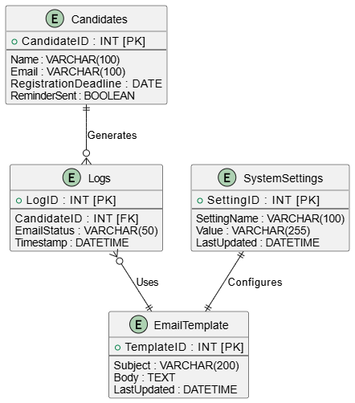
Table Design
ER Diagram (Entity-Relationship)

Slide 15
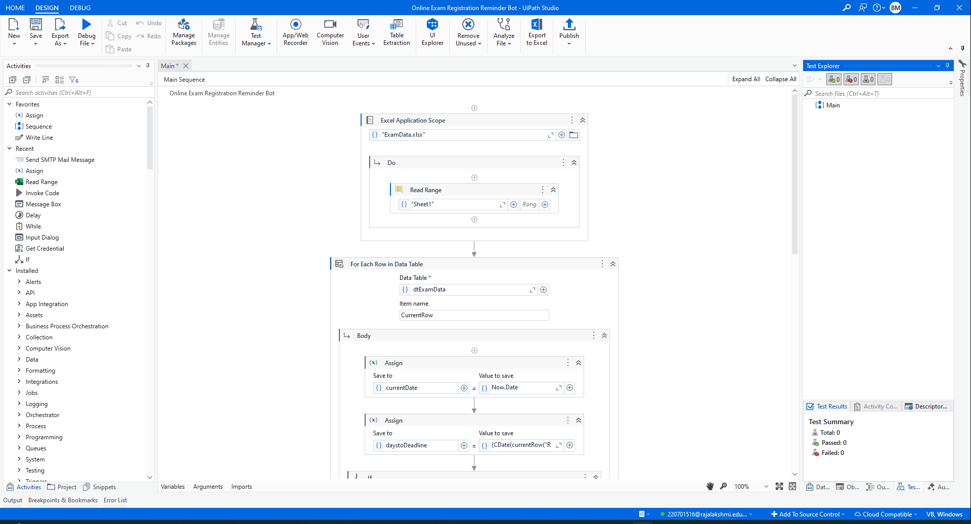
Process Design
Main Process

Slide 16
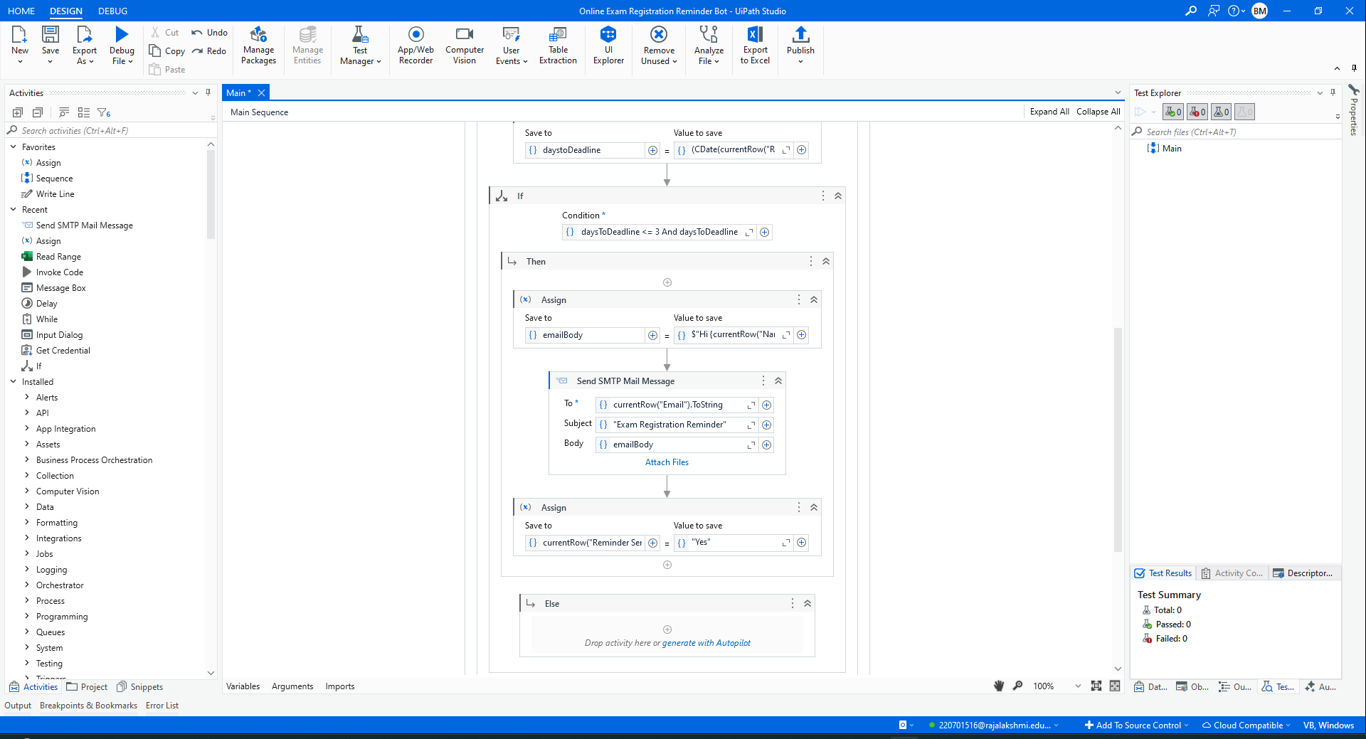
Process Design
Main Process

Slide 17
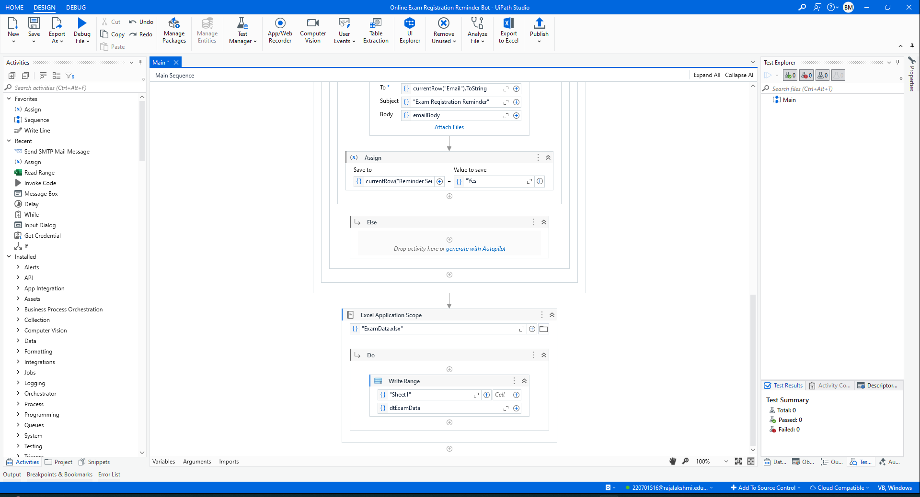
Process Design
Main Process

Slide 18
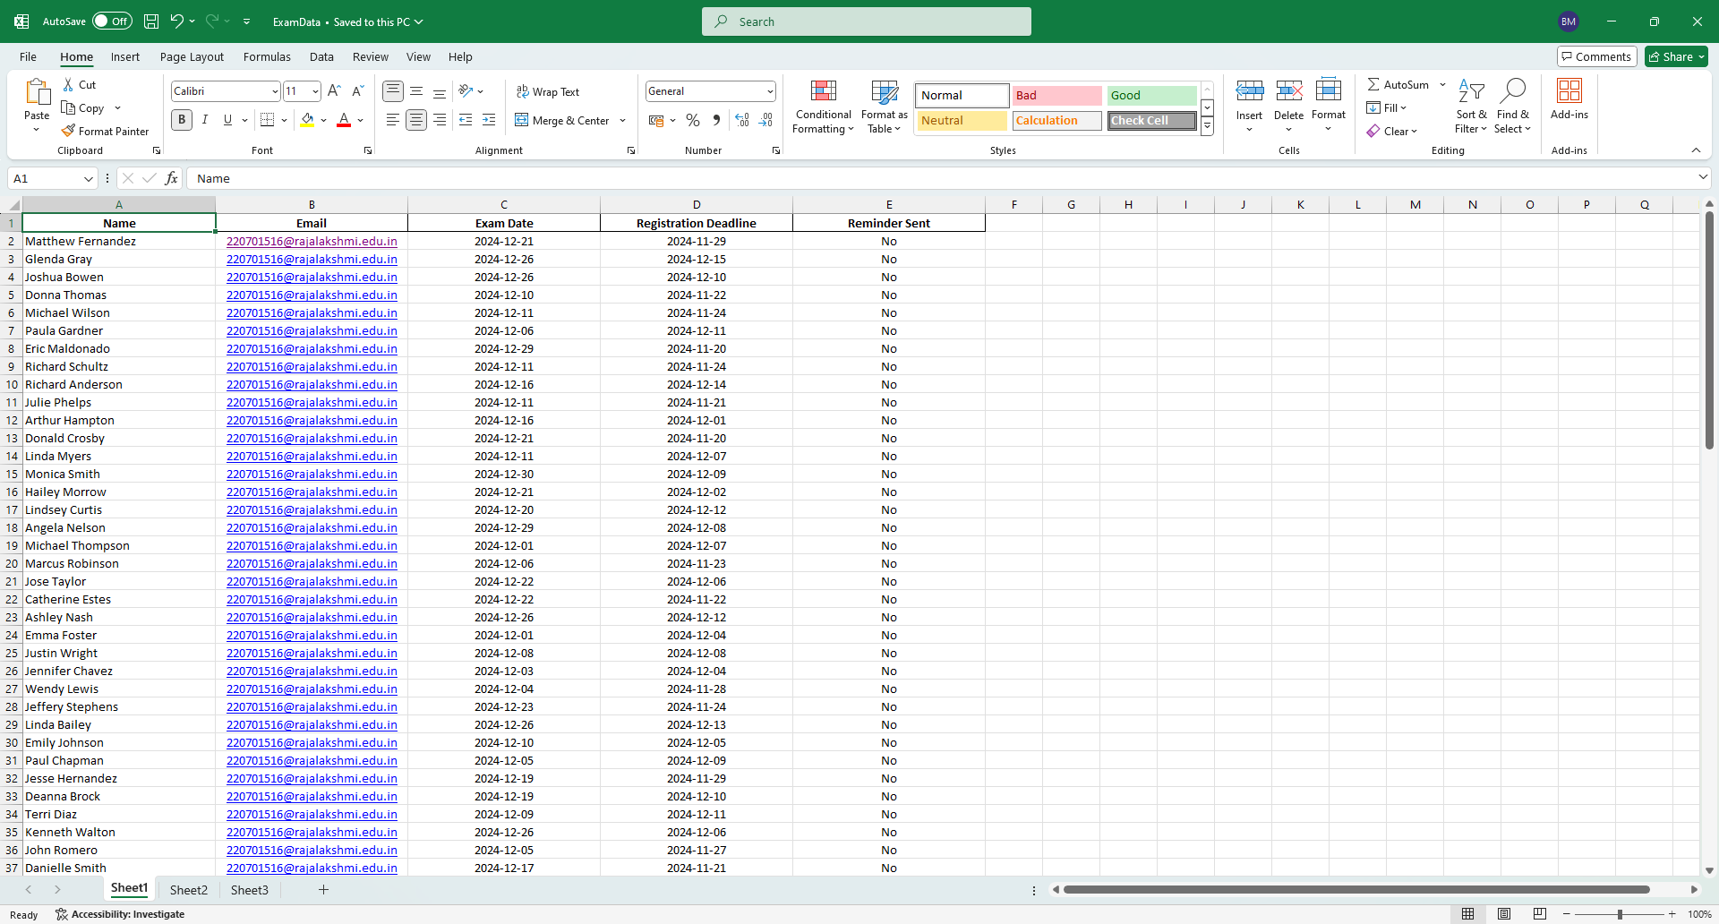
Implementation
Implementation of Module 1:
Data Input and Validation: This module reads and validates the data from the excel sheet, ensuring no errors or missing fields.

Slide 19
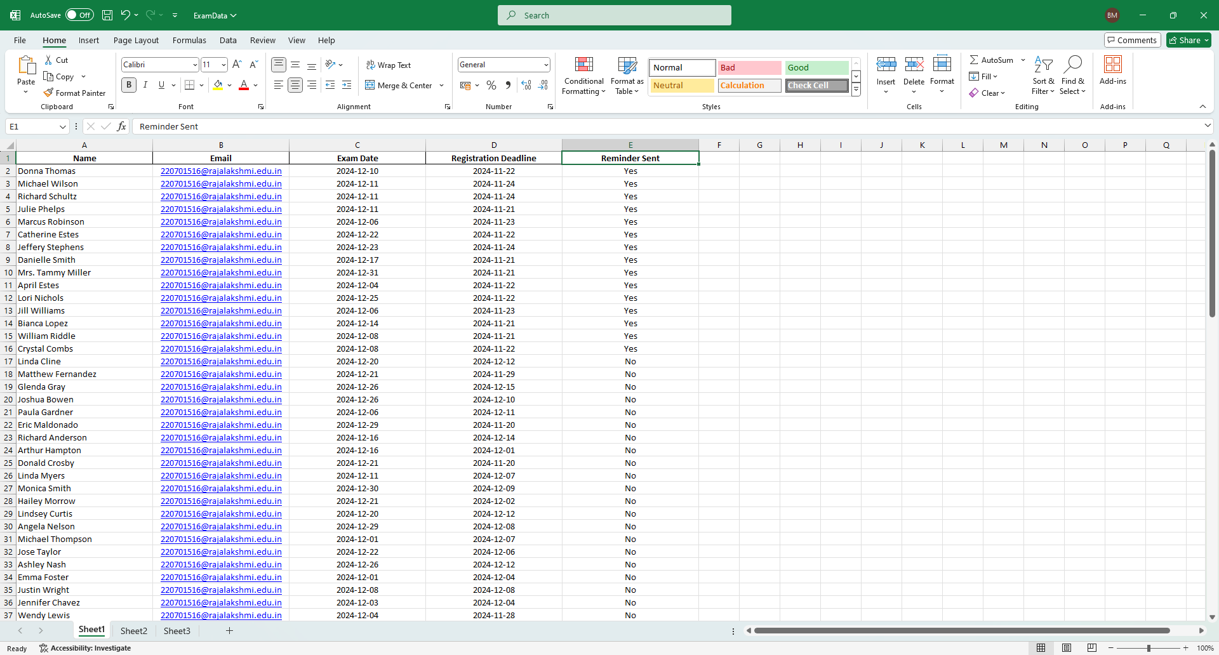
Implementation
Implementation of Module 2:
Reminder Sent Status Update: This module updates the "Reminder Sent" column in the Excel sheet after reminders are sent.

Slide 20
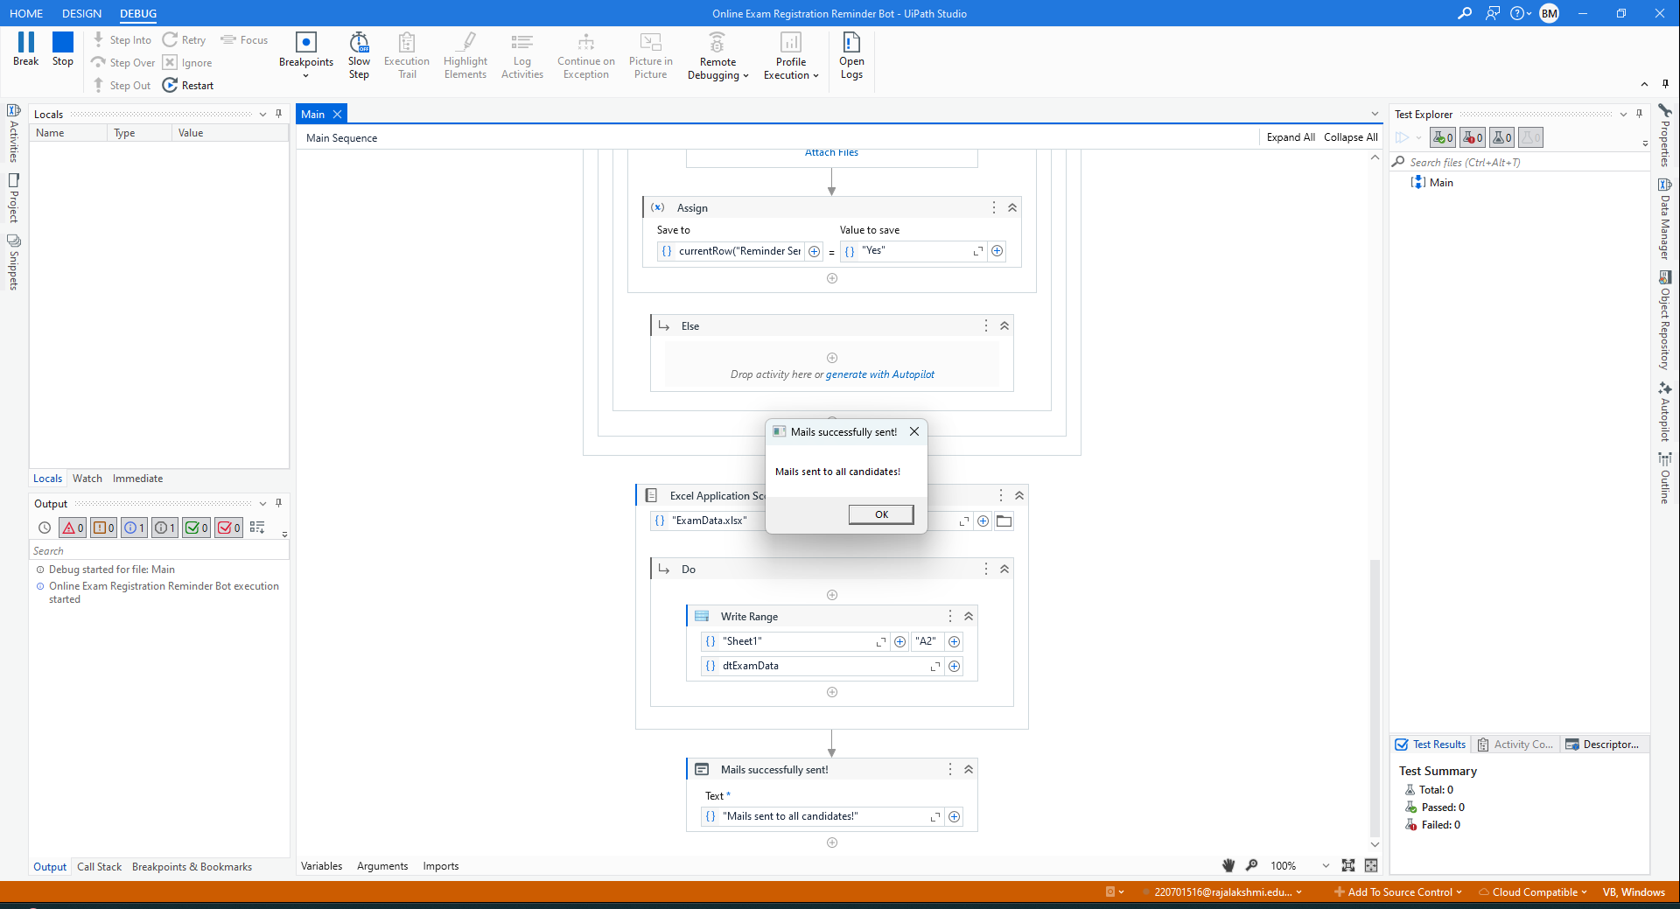
Testing
Screen shots:

Slide 21
Conclusions
The Online Exam Registration Reminder Bot provides an efficient and automated solution to ensure that students receive timely reminders about their exam registration deadlines. By leveraging UiPath Studio, this bot uses a combination of Excel data manipulation, email automation, and date-based logic to track and notify students of upcoming registration deadlines. The bot seamlessly integrates with Excel to read student data, check for approaching deadlines, and send personalized email reminders.
The project enhances the exam registration process by eliminating manual tracking and reducing the chances of missing registration deadlines. It ensures that students are promptly reminded, allowing them to take necessary actions on time. Furthermore, it saves administrative effort and enhances communication within educational institutions.
In conclusion, the Online Exam Registration Reminder Bot not only demonstrates the practical use of Robotic Process Automation (RPA) in managing critical workflows but also contributes to the overall efficiency and effectiveness of exam registration management systems. Through continuous enhancements and adaptations, such a bot could be further expanded to handle additional functionalities, ensuring a smooth and streamlined experience for both students and administrators.

Slide 22
Future Enhancement
Multi-Channel Notification Support
Description: Expand the system to include multiple notification channels, such as SMS, WhatsApp, or push notifications, alongside email reminders. This enhancement would ensure users receive reminders through their preferred medium, improving accessibility and user satisfaction.
Benefits:
- Wider reach and improved reliability of reminders.
- Enhanced user engagement and reduced chances of missed deadlines.
- Implementation Suggestion: Integrate APIs for SMS (e.g., Twilio) or WhatsApp messaging platforms to enable seamless communication.
AI-Driven Personalized Reminders
Description: Leverage AI to analyze user behavior, such as registration patterns or response times, and customize reminders. For example, users who frequently register late could receive more frequent notifications closer to the deadline.
Benefits:
- Increased effectiveness of reminders through tailored messaging.
- Improved user experience by addressing individual needs.
- Implementation Suggestion: Incorporate machine learning algorithms in the backend to evaluate past data and generate dynamic reminder schedules for each user.

Slide 23
IEEE Paper
Title: The Online Exam System Research Based on the MVC Framework
Author: Details not available from the preview.
Link: https://ieeexplore.ieee.org/document/9482049

Slide 24
References
[1] B. Shashi, R. Shashikala, and S. Sridhar, "Automating Academic Processes with Robotic Process Automation: A Case Study in Educational Institutions," International Journal of Educational Technology and Research, vol. 12, pp. 32-38, 2022.
[2] V. Kumar, P. Verma, and R. Prakash, "Leveraging Robotic Process Automation for Managing Student Information Systems in Educational Institutions," International Journal of Computer Applications, vol. 47, pp. 76-83, 2021.
[3] A. Sharma, K. N. Soni, "AI-driven Solutions for Exam Registration and Deadline Management," Journal of Artificial Intelligence and Education, vol. 15, no. 2, pp. 124-129, 2023.
[4] S. A. Raj, R. R. Singh, "The Role of Automation in Educational Workflow Optimization," Proceedings of the International Conference on Educational Innovations, 2021, pp. 112-117, do: 10.1109/ICEI53144.2021.9475682
[5] T. Mishra, M. D. Sharma, and S. Verma, "Robotic Process Automation in Education: Exploring the Benefits and Challenges," International Journal of Modern Education and Computer Science, vol. 13, pp. 56-63, 2020.
[6] J. C. Agarwal, "Designing an Efficient Email Reminder System for Educational Management," International Journal of Information Technology and Management, vol. 29, pp. 45-50, 2022.

Slide 25
Thank You

